Slide 1
Intro to Quantitative Methods in HCI
(or how to not lie with a t-test)
Prof. Benji Xie (“she”+”eh”), he|they
Asst. Professor of Computer Science, DU
benji.xie@du.edu benjixie.com

Slide 2

I’m Dr. Benji. I design human-data interactions for equity
Research: AI evaluation, AI-assisted programming
Previously…
Postdoc @ Stanford
PhD @ University of Washington Information School (w/ Prof. Al!)
“4+1” at MIT
Ebay, Code.org, a few tech start-ups
Notes:
Benjamin designs techniques for equitable uses of data and AI in computer science classrooms and local communities.
Previously, he was a Postdoctoral Fellow with Stanford University’s Graduate School of Education, Human-Centered AI Institute, and McCoy Center for Ethics in Society. He received his PhD in information science from the University of Washington, Seattle.

Slide 3
How have I used quantitative methods?
Objective measures: Comparing to agreed upon standard
Measuring performance w/ atests
Measuring temperature, sound, light
Subjective measures: individual or relative evaluation
Surveys of participants
Behavioral data: measuring people’s behavior
Keystroke logs
Eye tracking data
Logs of how users navigate app or website

Slide 4
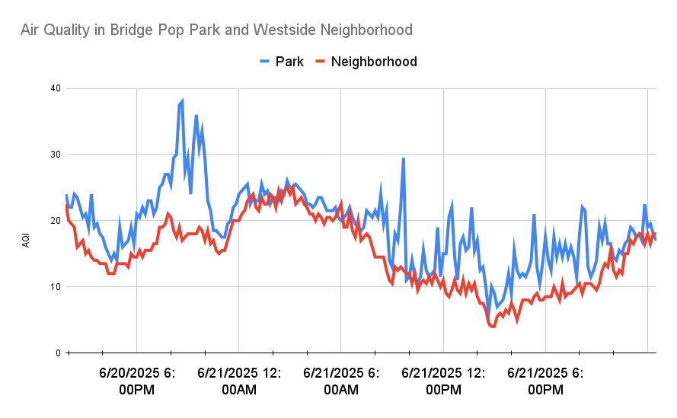
There is a difference in air quality in the park vs the neighborhood. Is it “significant?”
Air quality in park is worse at the park than the neighborhood
Air Quality is steadily higher

Slide 5
Learning Objectives
Understand what a p-value means
Understand how to conduct a t-test
Check assumptions: normality, homoscedasticity (continuous, independence)
Measure effect size
Understand how to apply a t-test in Python
Recognize limitations of a t-test and other approaches to mitigating these limitations

Slide 6
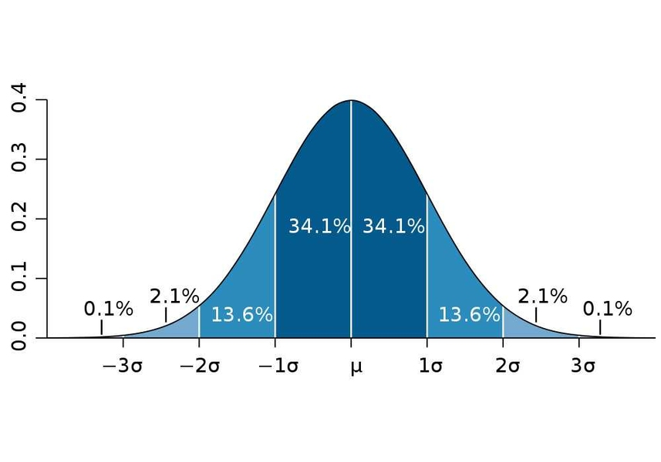
Stats review: normal distribution (“bell curve”)
Represented by two values
μ: mean (measure of central tendency)
𝝈: standard deviation (measure of spread)

Slide 7
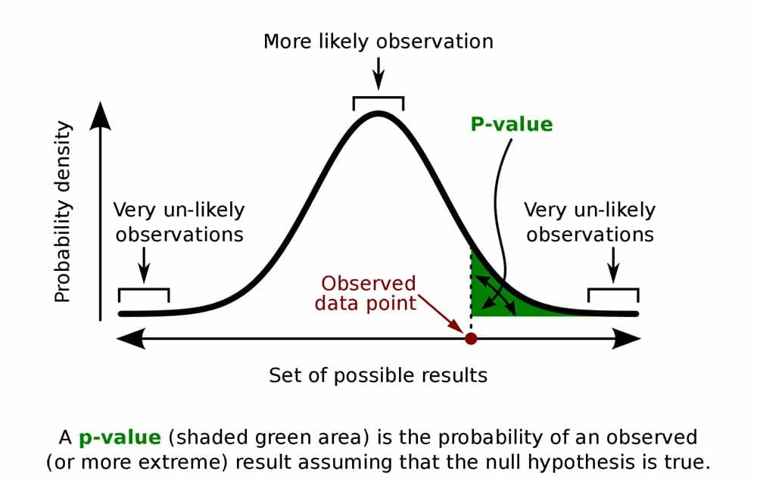
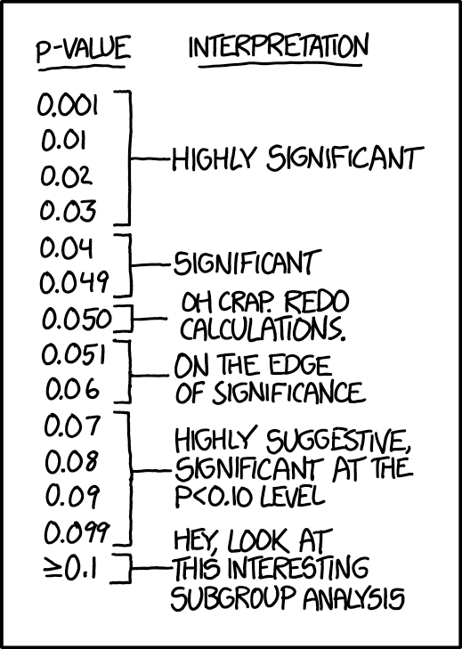
DISCUSS: What do you think a p-value means? Why does it matter?

Slide 8
P-Value: Probability that data supports the null hypothesis
p=0.031 => 3.1% probability that data supports the null hypothesis

Slide 9
Typical thresholds (⍺): 0.05*, 0.01**, 0.001***

Slide 10
What to do with a p-value:
If p<⍺ where ⍺ = {0.05, 0.01, 0.001}, we reject the null hypothesis (“significance”)
If p≥⍺, we have insufficient data/fail to reject the null hypothesis (“not significant”, n.s.)
w/ frequentists approaches, we can never accept a null hypothesis. Bayesian approaches help with that

Slide 11
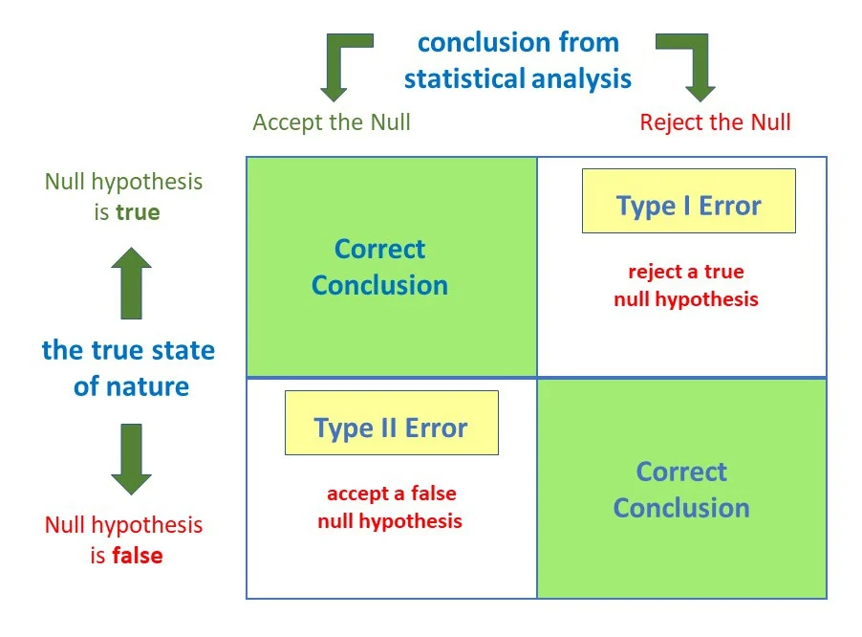
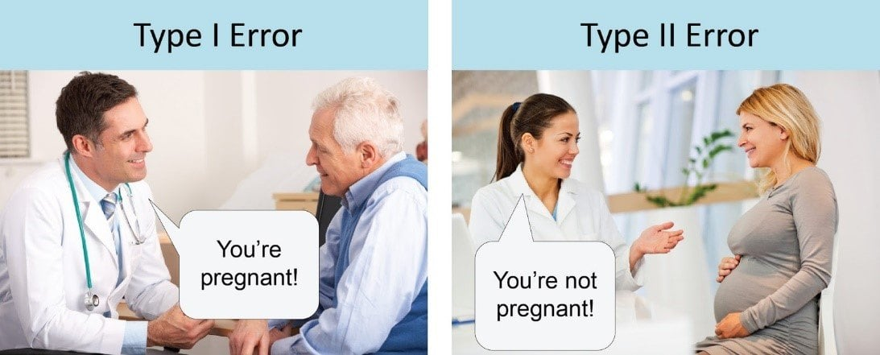
Types of errors
Type I error: false positive (reject null hypothesis when it’s actually true)
Type II error: false negative (fail to reject null hypothesis when it’s actually false)

Slide 12
DISCUSS: How does changing p-value threshold from 0.05 to 0.01 affect Type I or Type II errors? (if at all)
Type I error: false positive (reject null hypothesis when it’s actually true)
Type II error: false negative (fail to reject null hypothesis when actually false)

Slide 13
DISCUSS: How does changing p-value threshold from 0.05 to 0.01 affect Type I or Type II errors? (if at all)
Type I error: false positive (reject null hypothesis when it’s actually true)
P-value directly related to Type I error. => changing α from 0.05 to 0.01 decreases Type I error
Type II error: false negative (fail to reject null hypothesis when actually false)
P-value inversely related to Type II error. => changing α from 0.05 to 0.01 increases Type II error

Slide 14
t-tests: how we use p-values to determine significant difference

Slide 15
t-test: determines difference in mean between 2 groups
1 factor (categorical independent variable)
2 levels (values or groups within factor)
e.g. factor: input device. Levels: mouse, touchpad
Two kinds of t-test
Independent/two-sample/student’s: groups from 2 different populations (between subjects
e.g. surveying people who went to Taylor Swift concert and people who did not
Paired t-test: same population (within subjects)
pre & post test, repeated samples
e.g. measuring people’s motor functions before, during, and after attending Taylor Swift concert

Slide 16
DISCUSS: Which t-test for each setup (or neither)
Understand typing speed of two bird species: mallard vs stellar jay
Determine number of native bird species UGs of different years (freshman, sophomore, junior, senior) can name
Measure time it takes neurodiverse programmers to complete a given task with and without AI assistance.
Determine the relationship between age and number of Taylor Swift songs someone can recite from heart

Slide 17
DISCUSS: Can we use a t-test?
Understand typing speed of two bird species: mallard vs stellar jay
✅ 1 factor: bird species. 2 levels: {mallard, stellar jay}
Determine number of native bird species UGs of different years (freshman, sophomore, junior, senior) can name
❌ >2 levels (frosh, soph, …). Could change to underclassmen & upperclassmen
Measure time it takes neurodiverse programmers to complete a given task with and without AI assistance.
✅ 1 factor: AI assistance. 2 levels: {with, without}.
Determine the relationship between age and number of Taylor Swift songs someone can recite from heart
❌ > 2 levels (age). Could change to {child (<18 yrs old), adult (18+ yrs old)}

Slide 18
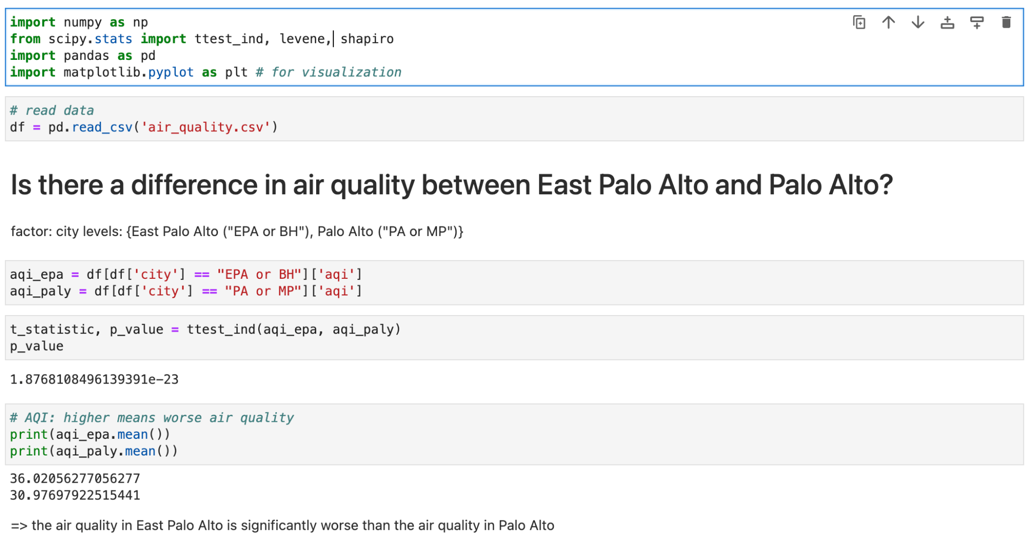
Example of t-test

Slide 19
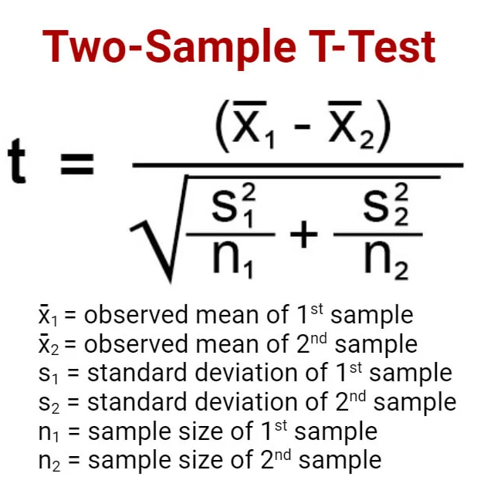
Assumptions of t-test…
Assumptions we justify by argument:
Data is continuous
Independent samples
Assumptions we can test for:
Normality: data approximately fits normal distribution
Homoscedasticity (same variance)

Slide 20
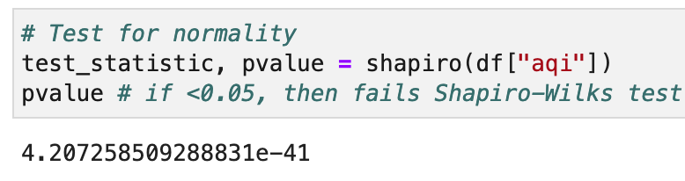
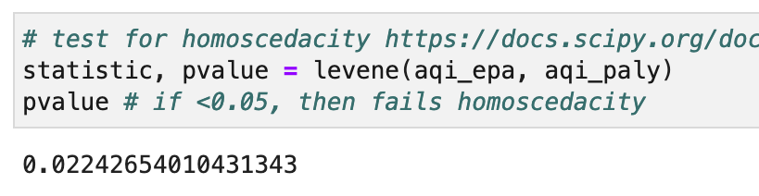
Testing for assumptions
Normality: Shapiro-WIlks
Homoscedasticity: Levene’s Test
Homoscedasticity: Levene’s Test

Slide 21

Effect Size: The important thing everyone forgets
Value measuring strength/magnitude of relationship between two variables
Calculate only if significant (p<⍺)
For t-tests: Cohen’s d
0.2: small
0.5: medium
0.8: large

Slide 22
Conclusion: Beyond t-tests

Slide 23
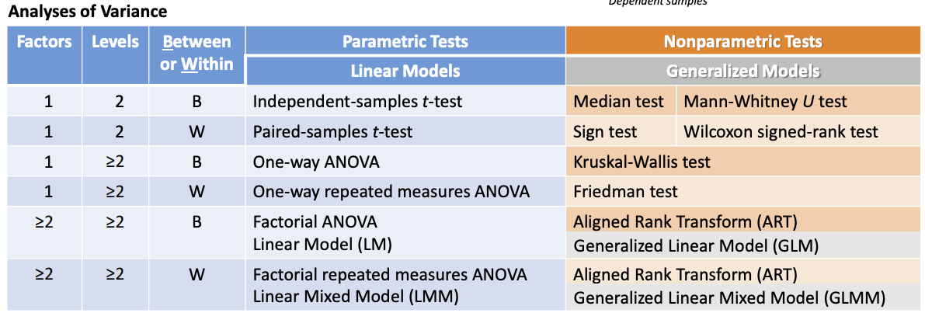
Other ANOVA tests
data not normal, variance not same
more than 1 factor or level
https://depts.washington.edu/acelab/proj/Rstats/index.html

Slide 24

Bayesian Approaches
Can provide evidence to accept null hypothesis
More robust approaches, but less understood

Slide 25
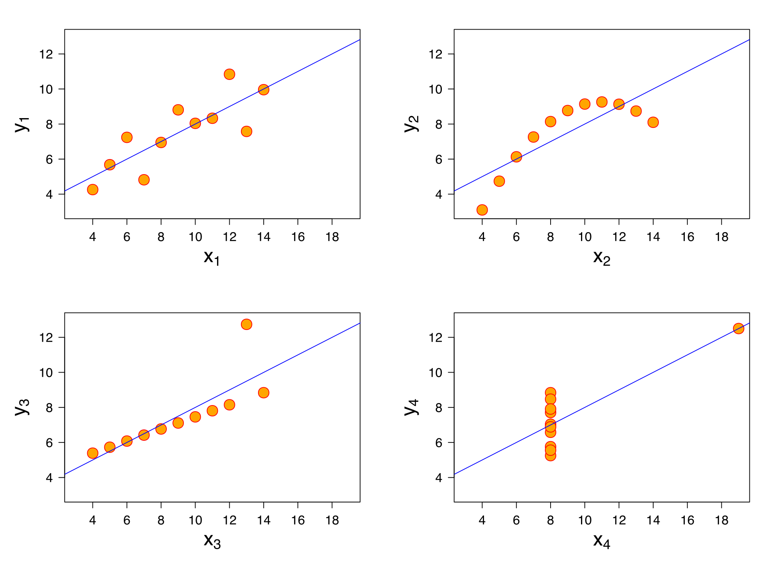
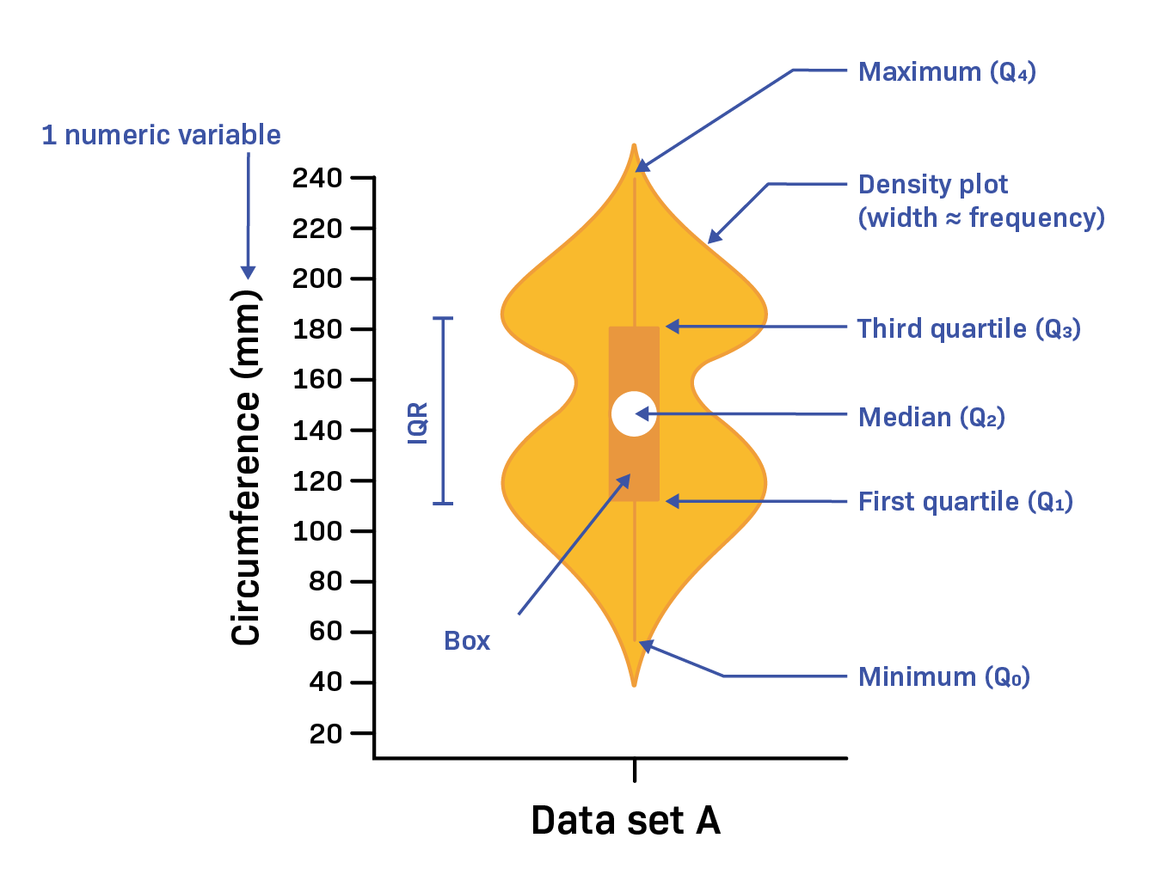
VISUALIZE your distribution, check ASSUMPTIONS
Explore data yourself, show data to others
Example: Anscombe’s quartet (Same mean & variance)
Show each data point >> violin plot >> box plot
Anscombe’s quartet

Slide 26
SHAMELESS PLUG: Join the DUHCI Group! 🦆
If you are work-study eligible, apply to be our lab manager!
Interested in any of the projects I’m working on? Reach out!
Usability of AI-assisted programming tools for neurodiverse programmers
Understand how people with different kinds of sexism use AI differently
Evaluating the impact of AI on CO communities (quantitatively, qualitatively)
@benji xie on Slack | benji.xie@du.edu | ECS 355

Slide 27
Learning Objectives
Understand what a p-value means
p(data|hypothesis)
Understand how to conduct a t-test
1 factor, 2 levels. Between or within subjects
Check assumptions: normality, homoscedasticity (continuous, independence)
Measure effect size
Understand how to apply a t-test in Python
R is easier
Recognize limitations of a t-test and other approaches to mitigating these limitations
Assumptions, 1 factor & 2 levels, reliance on arbitrary thresholds (⍺={0.05, 0.01, 0.001})

Slide 28
Intro to Quantitative Methods in HCI (or how to not lie with a t-test)
Prof. Benji Xie (“she”+”eh”), he|they. Asst. Professor of Computer Science, DU benji.xie@du.edu benjixie.com
Conducting a t-test
1 factor, 2 levels
Visualize distribution (for self, audience)
Check assumptions (normality, homoscedasticity)
Report effect size

